Slide 1


Hyperspectral Remote Sensing Image Classification Based on Convolutional Neural Network
GNR 652, Machine Learning for Remote Sensing - 1
Submitted to :
Prof. Biplab Banerjee
CSRE, IIT Bombay
Submitted by :
Shiva Teja (22M0304)
Mohit Mandloi (22M0310)
Amit Kumar (22M0330)

Slide 2
Motivation
Hyperspectral imaging provides rich spectral information for distinguishing objects that are indistinguishable with traditional remote sensing.
However, current feature extraction algorithms rely heavily on prior knowledge, making it difficult to fully understand all the information in hyperspectral data and resulting in poor model generalization.
Additionally, classification of hyperspectral data is challenging due to a high number of spectral channels, limited training samples, and large spatial variability.
Combining spatial and spectral information is crucial for accurate classification of three-dimensional hyperspectral image data. Utilizing both types of information leads to more accurate classification and is in line with the unique characteristics of hyperspectral data.

Slide 3
Introduction
As hyperspectral imagers continue to advance, the amount of information within hyperspectral images will increase, expanding their potential for diverse applications.
Hyperspectral image classification method only used the rich spectral information in hyperspectral images and did not dig deeper into the intrinsic information of the data. For example, distance classifier , K nearest neighbor classifier, maximum likelihood classifier.
Compared with the traditional methods, deep learning technology such as Convolutional Neural Network (CNN) has good performance in image classification and pattern recognition.

Slide 4
Introduction
In recent years, with the development of Neural Network (NN), CNN is more and more widely applied to the classification of remote sensing data, such as Multilayer Perceptron (MLP) and Radial Basis Function (RBF).
Experimental results show that the proposed network structure can promote the classification of hyperspectral images and provide higher classification accuracy.

Slide 5
Research Gap
SVM aims to transform low-dimensional linearly inseparable problems into higher dimensions to enable accurate classification. Although kernel transformation achieves satisfactory accuracy, selecting the optimal combination of kernel function and parameters remains challenging.

Slide 6
Objective
To improve the classification efficiency by using the 3D-CNN as compared to Support vector machine (SVM) in Hyperspectral images to get the rich spatial and spectral information.

Slide 7
Convolutional Neural Networks
The four basic features of CNN are:-
Local interconnection
Weight sharing
Down sampling
Multiple convolutional layers
Input layer
Convolution
Down sampling
Fully connected
Output layer
layer
layer
layer
Fig. : Typical CNN structure

Slide 8
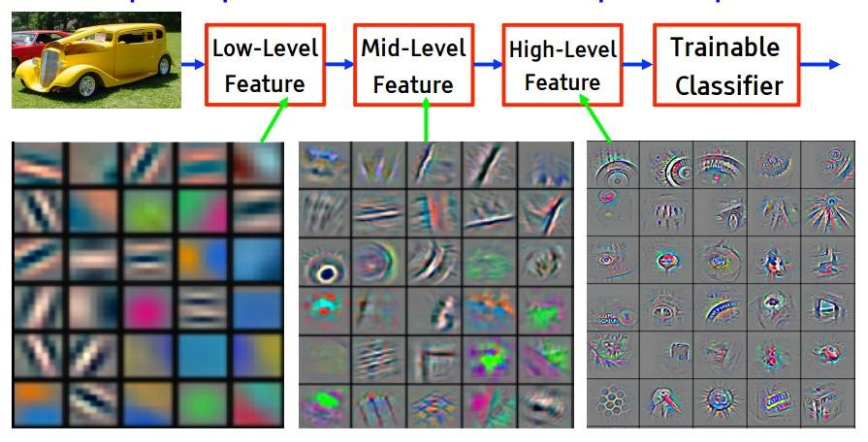
Convolutional Neural Networks

Slide 9
3D-Convolutional Neural Networks (CNN)
In the processing of three-dimensional data, 2D-CNN can not meet the requirements and applied it to human motion recognition.
For such three-dimensional data, 3D-CNN is more suitable for the representation than 2D-CNN, hyperspectral image data can be considered as three-dimensional data when joint spectral-space information is classified, so it is feasible to classify it using 3D-CNN.
The basic structure of 3D-CNN is similar to that of 2D-CNN, except that both the convolution kernel and the feature map are three-dimensional.

Slide 10
3D-CNN classification structure
Hyperspectral Images
Three-dimensional
image blocks
3D-CNN
Input layer
The method consists of five layers: Input layer, convolution layer, maximum pooling layer, full connection layer and output layer.
Convolution layer
Maximum pooling
layer
Fully connected
layer
Output layer
Classification results
Fig. 3D-CNN classification structure diagram

Slide 11
Support Vector Machines (SVM)
SVM stands for Support Vector Machine, which is a machine learning algorithm used for classification and regression analysis. It is a supervised learning method that uses a discriminative model to predict the class.
The algorithm tries to find a hyperplane that separates the data points of different classes with the maximum margin. The margin is the distance between the hyperplane and the closest data points of each class.
The hyperplane that maximizes the margin is the optimal solution and is used to classify new data points.
A new statistical learning technique called Support Vector Machines (SVM) has the benefits of high precision, quick computation, and strong generalizability.

Slide 12
Support Vector Machines
The basic goal of SVM is to accurately classify data by converting a low-dimensional, linearly indivisible problem into a high-dimensional one.
Although the kernel transformation approach produces a respectable level of classification accuracy, selecting the right kernel function and appropriate parameters remains challenging.

Slide 13
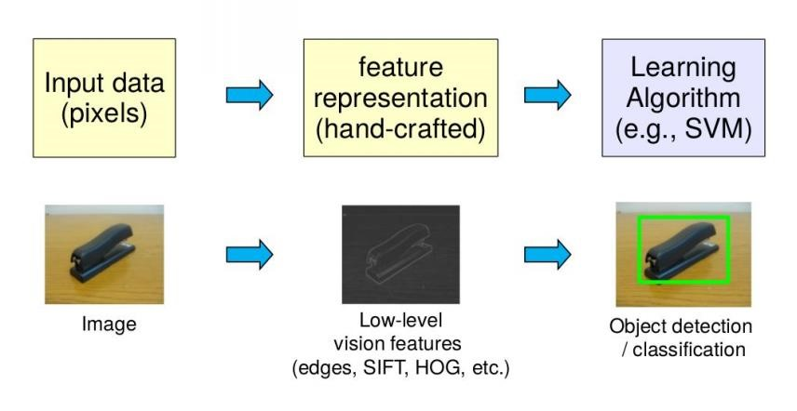
Support Vector Machines

Slide 14
Comparison of 3D-CNN with SVM Method
Compared to SVM, 3D-CNN can attain superior and more consistent classification accuracy. While 3D-CNN may require more time for training, it can exhibit faster convergence when working with a small training dataset and high-quality experimental equipment

Slide 15
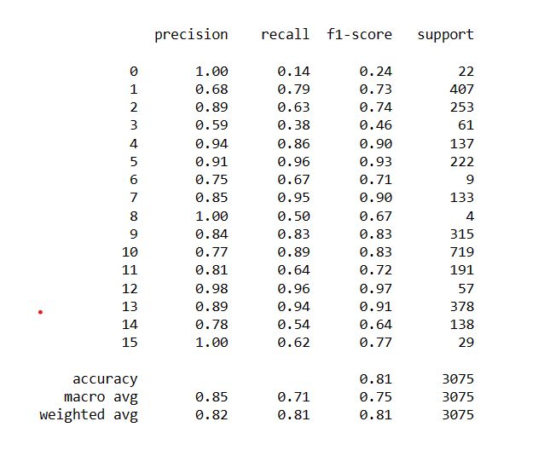
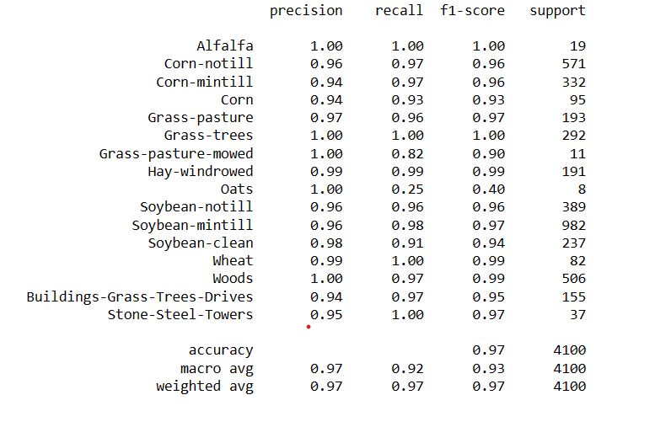
Results: Classification Report Comparison
Fig. : CNN classification report
Fig. : SVM classification report

Slide 16
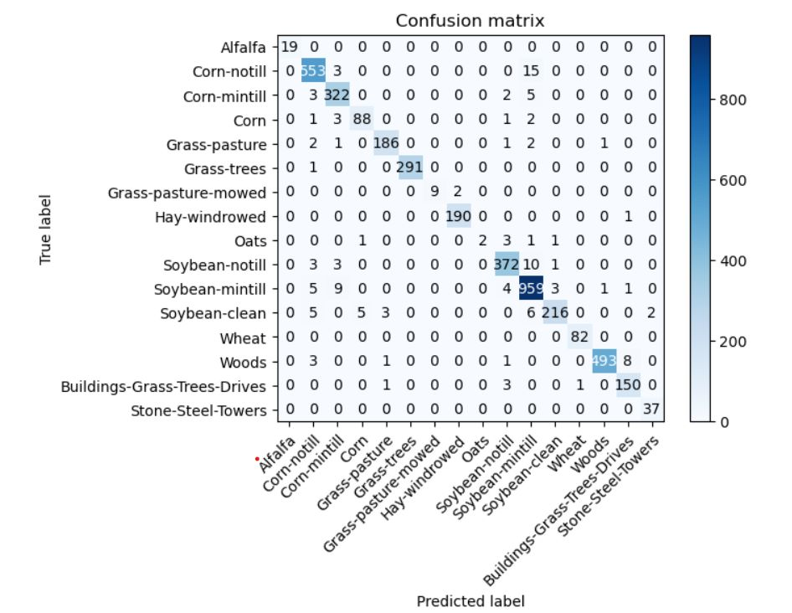
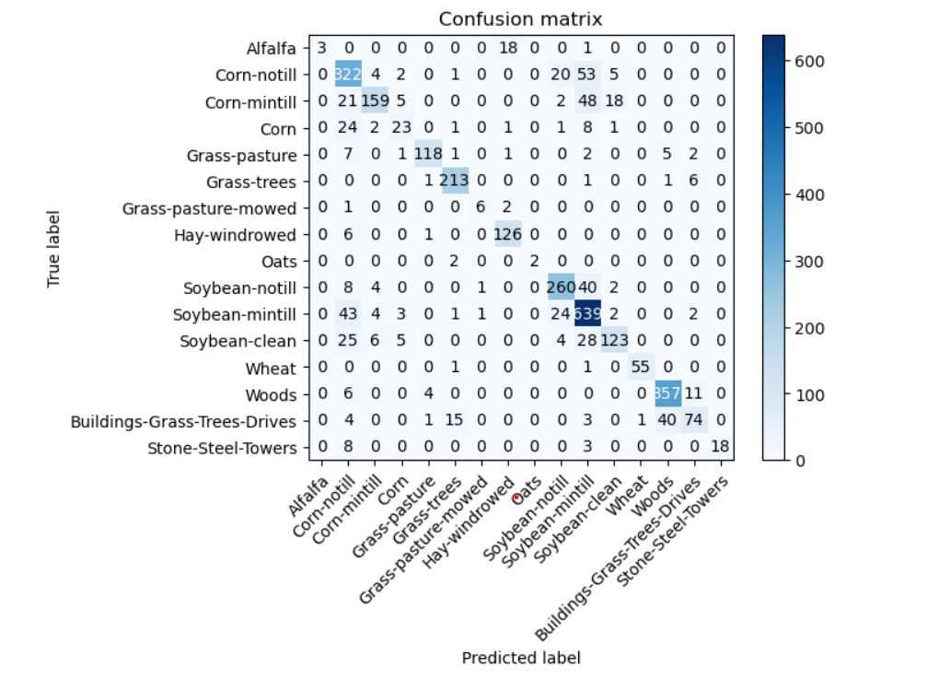
Results: Confusion Matrix Comparison
Fig. : CNN Confusion Matrix
Fig. : SVM Confusion Matrix

Slide 17
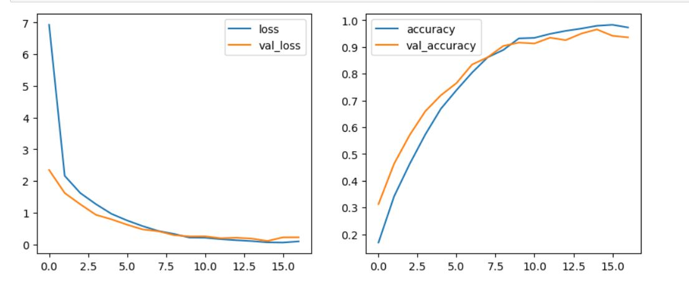
Results: CNN Accuracy and Report
Fig. : CNN Accuracy and Loss graph of training data and validation data

Slide 18
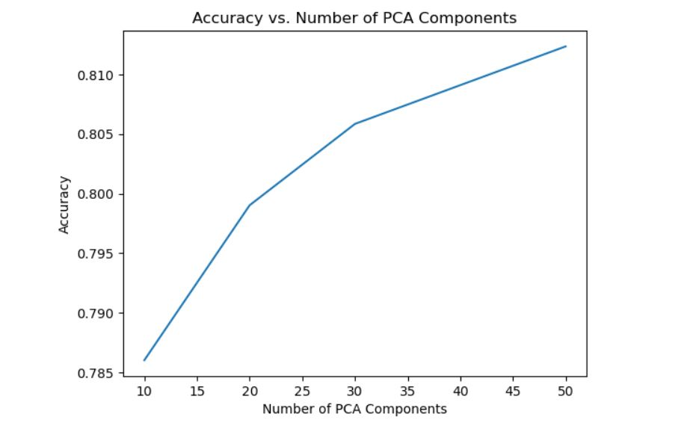
Results: SVM Accuracy
Fig. : SVM accuracy vs. No. of PCA components

Slide 19
Conclusion
The paper proposes a 3D-CNN-based method for hyperspectral image classification. The method increases the weight of the network to improve the classification accuracy of small sample data by increasing its attention to these samples. The experimental results show that the proposed method outperforms traditional SVM classifiers also with different PC components.

Slide 20
References
[1] M. Chao and G. Meng-Yuan, "Hyperspectral Image Classification Based on Convolutional Neural Network," 2018 5th International Conference on Information, Cybernetics, and Computational Social Systems (ICCSS), Hangzhou, China, 2018, pp. 117-121, doi: 10.1109/ICCSS.2018.8572435.

Slide 21
Thank you…

